Slide 1
Raspberry Pi NAS
Lester Voon Diarmaid Walsh

Slide 2
Summary
A NAS (Network attached storage) allows files to be accessed anywhere through WIFI or ethernet.
Can easily access files.
Low power.
Done using Samba package.
Using a VPN will allow access from anywhere.

Slide 3
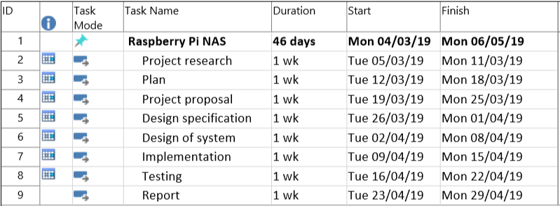
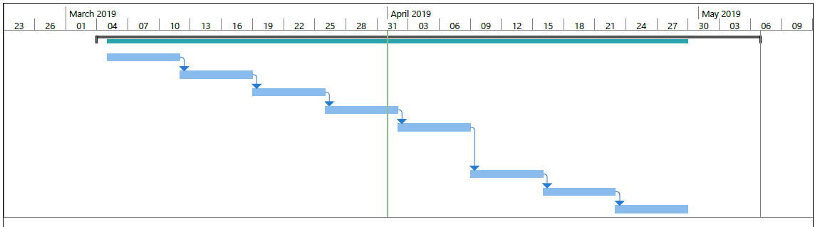
Gannt diagram

Slide 4
Repositories
We used GitHub to back up and store our project files.
If data is lost or deleted, it can easily be recovered.
Allows group members to access the files remotely.

Slide 5
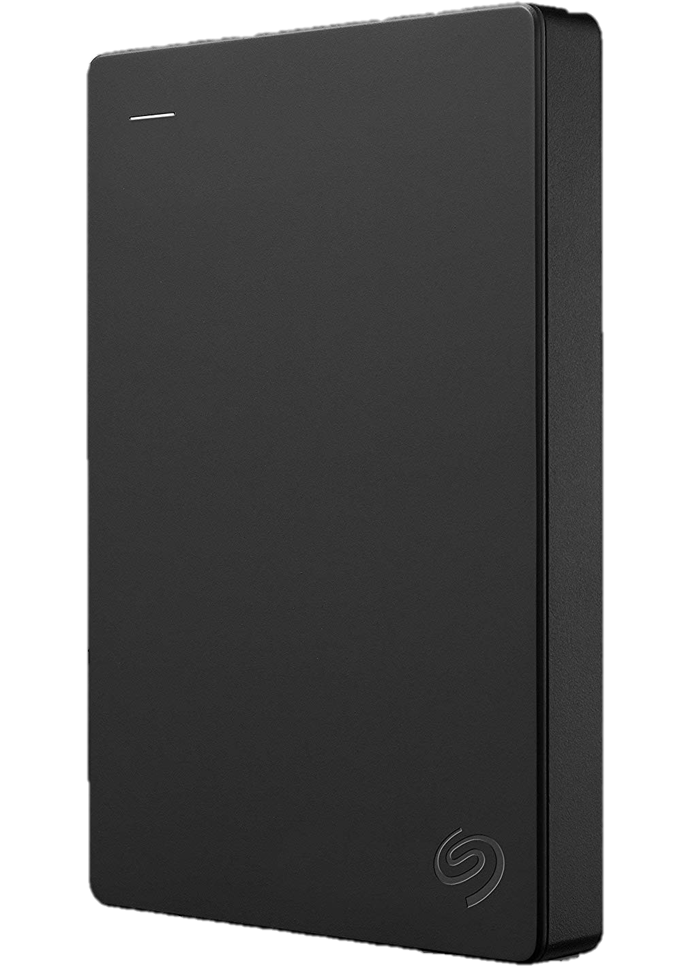
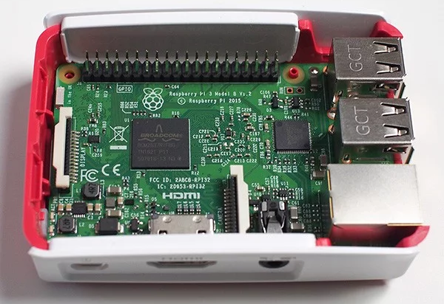
Design Specification
Raspberry Pi 3 Model B+
ARM Cortex-A53 CPU 1.4GHz
SRAM of 1GB
External drive
Form factor of 2.5 Inch
1TB storage

Slide 6
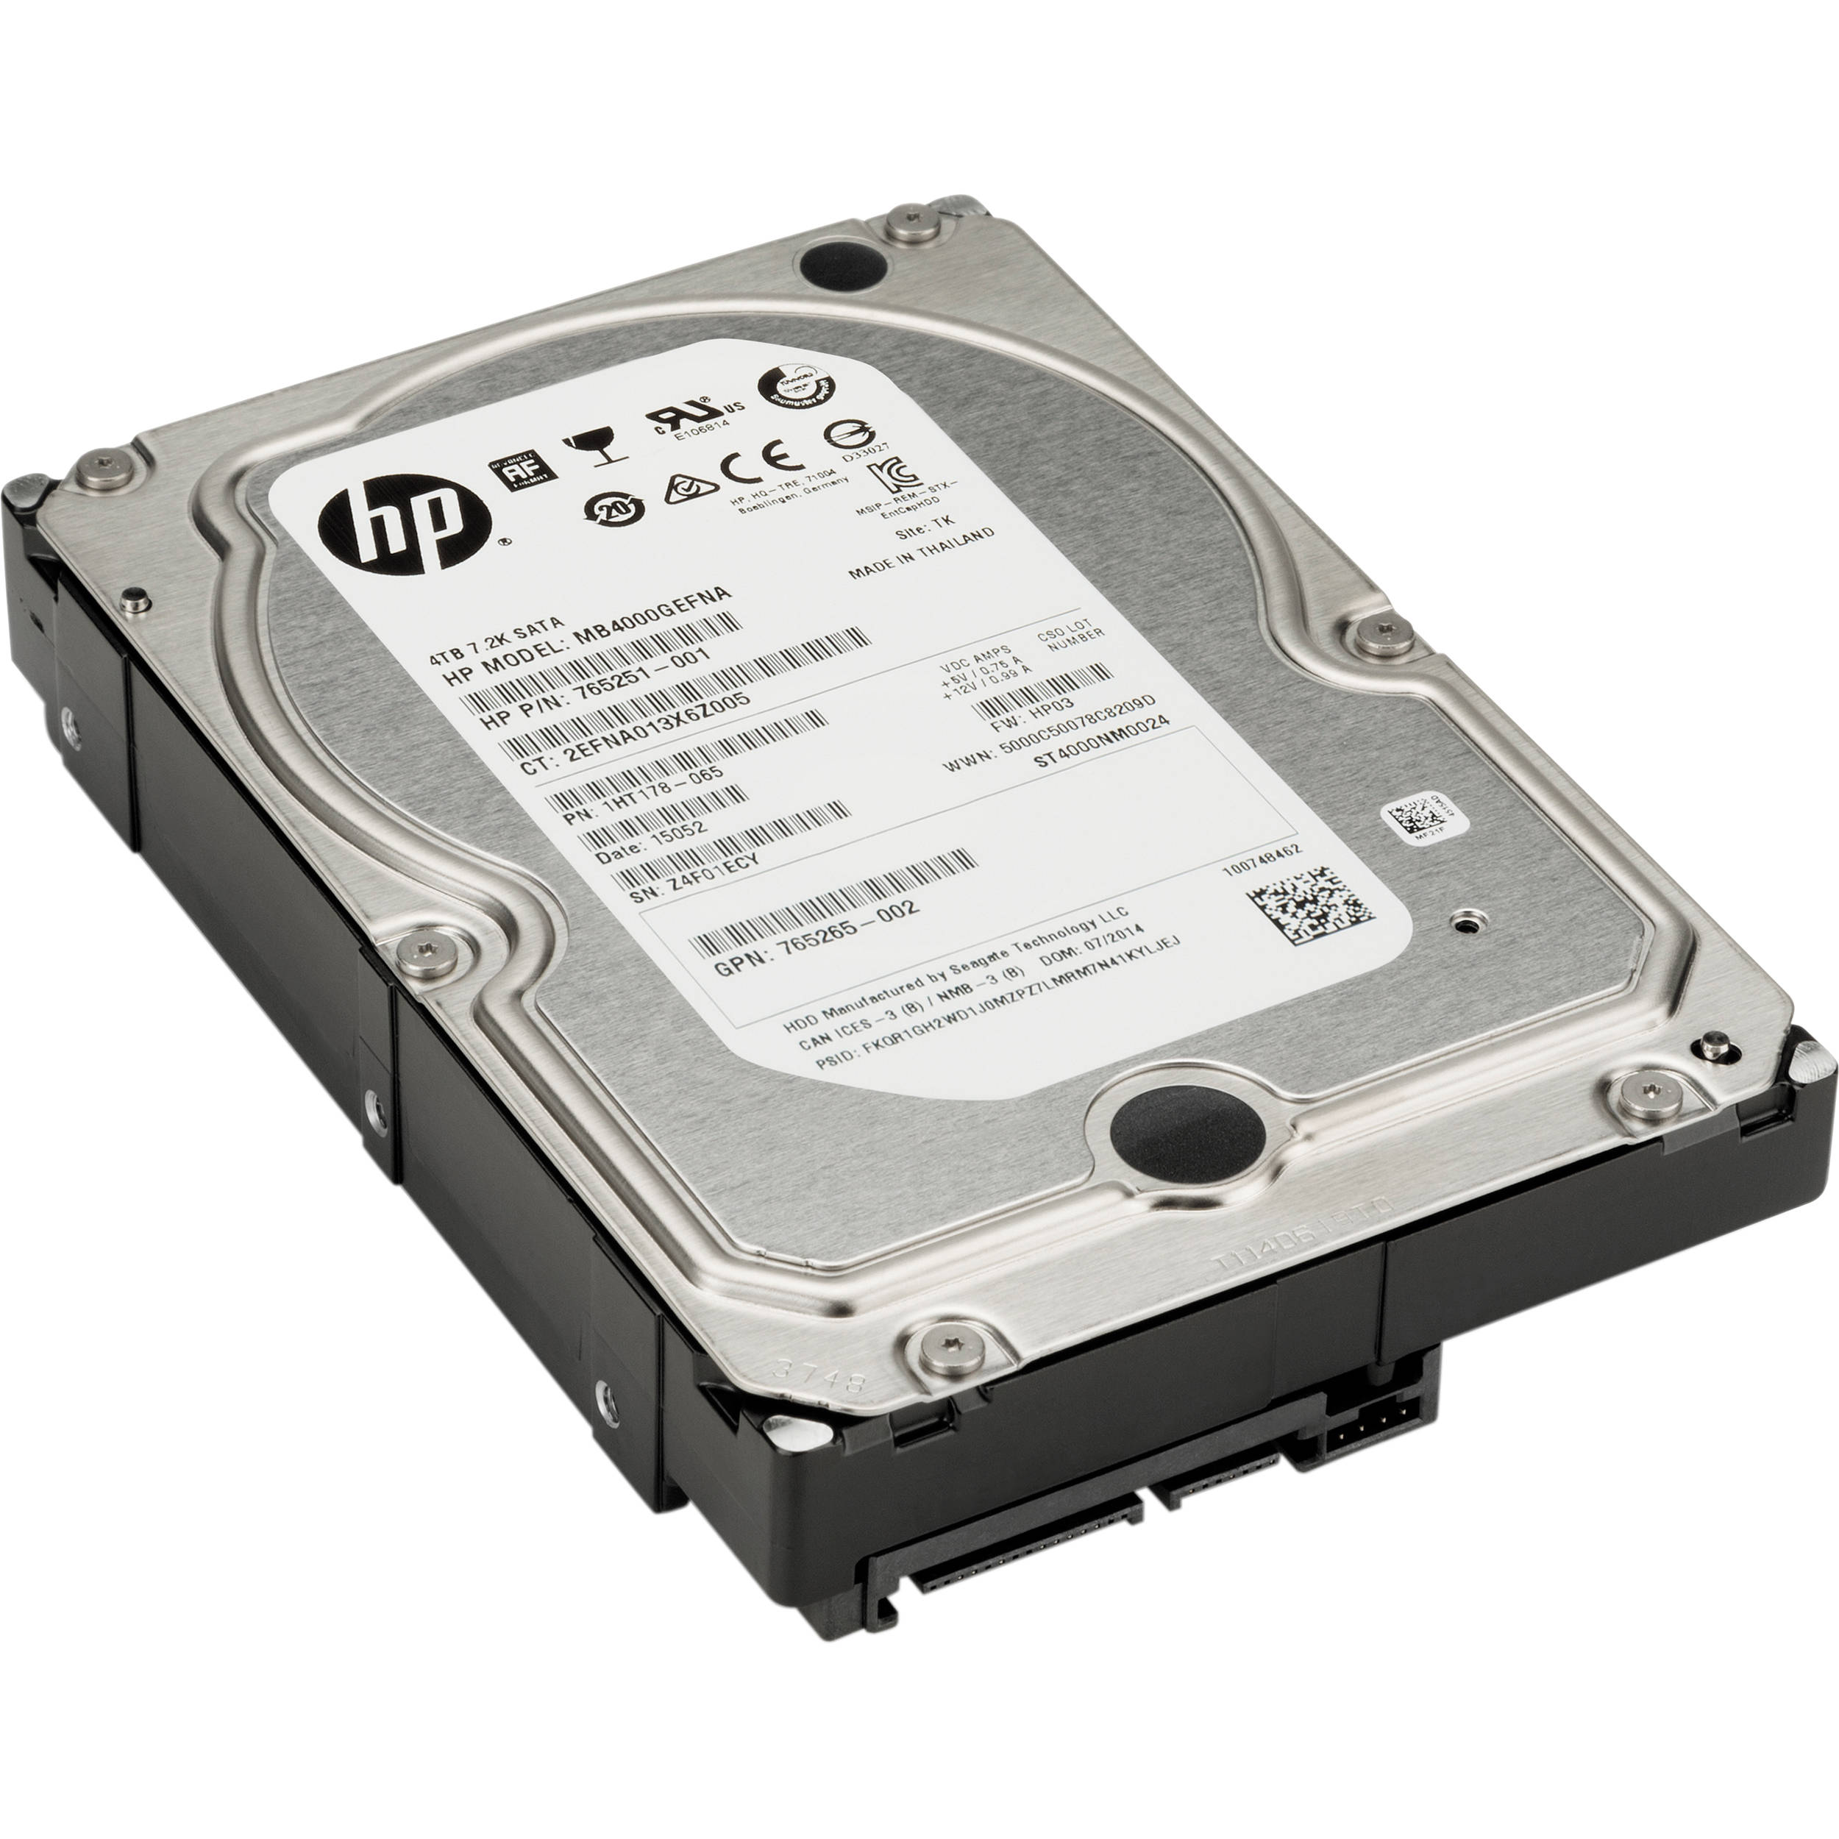
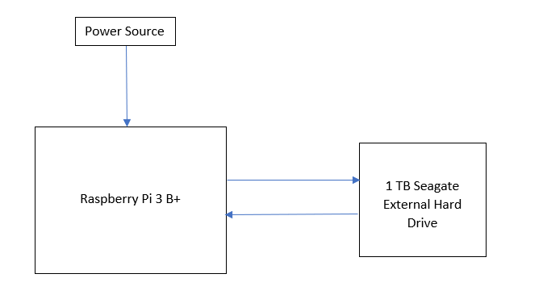
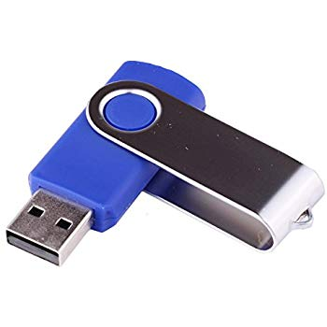
Design of system
Solution
Comparisons
Raspberry Pi connected to 1 TB Hard drive.
Access NAS through the IP Address of the Raspberry Pi on other devices.
Using USB as storage device.
Using provided Hard drive as storage device.

Slide 7
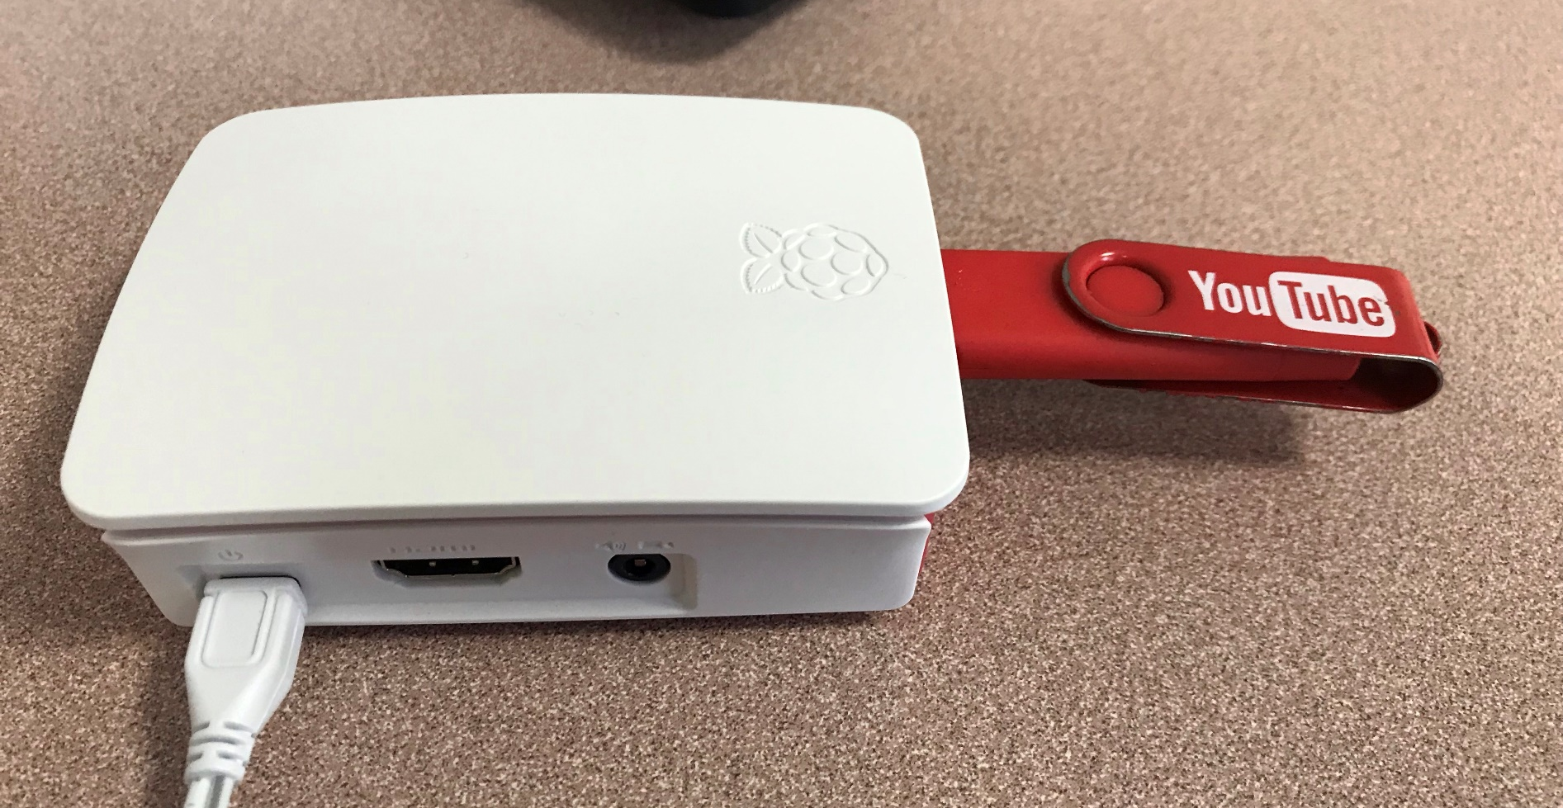
Implementation
As a basic test, a USB was used as the storage device to connect to when accessing the NAS.
This was verified to be working by creating a file on Raspbian and accessing it through a PC.
The main test used the External drive as the storage device connected to the Raspberry Pi.
This was verified to be working and the test deemed successful.

Slide 8
Cost
No. | Qty. | Description | Price | Comments
1 | 1 | Raspberry Pi 3 Model B+ Starter Pack | €60.00 | Provided by the college
2 | 1 | External Hard Drive | €50.00 | Shared among group members
Total |  |  | €110.00

Slide 9
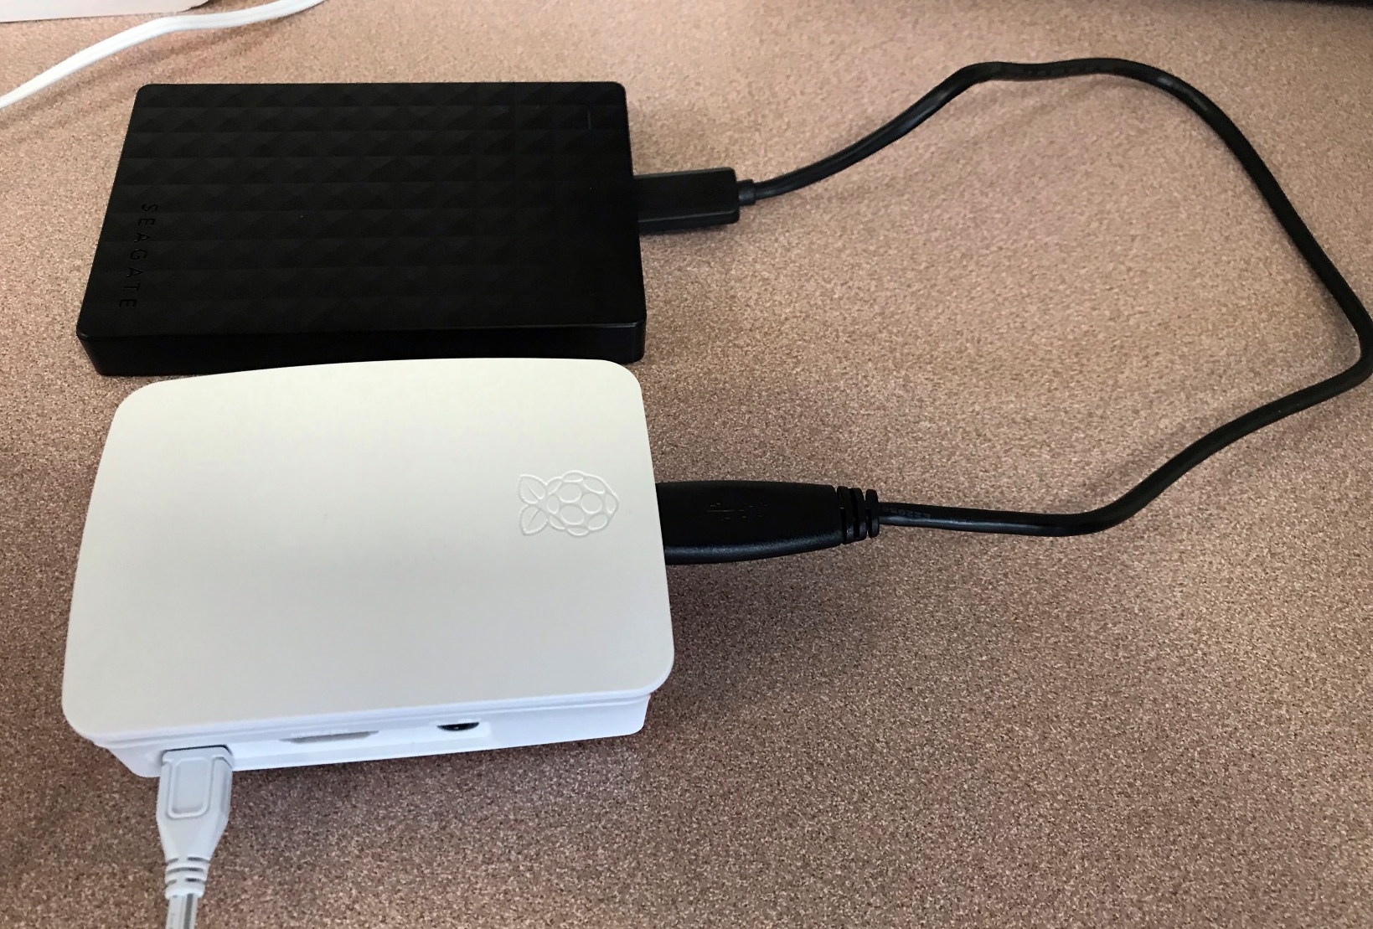
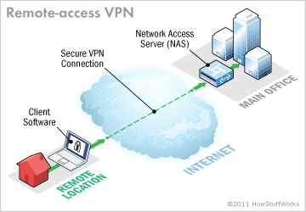
Results and conclusion
Files can be created, stored and accessed on the Raspberry Pi NAS using the external hard drive.
Must all be on the same network.
Requires IP and password to be accessed.
Cheap in comparison to other NAS systems e.g. Synology.
Low power, cheaper long term.
VPN implementation would allow remote access.
Extra cost associated with VPN, so not implemented.

Slide 10
Thank you
Any Questions?

